Slide 1
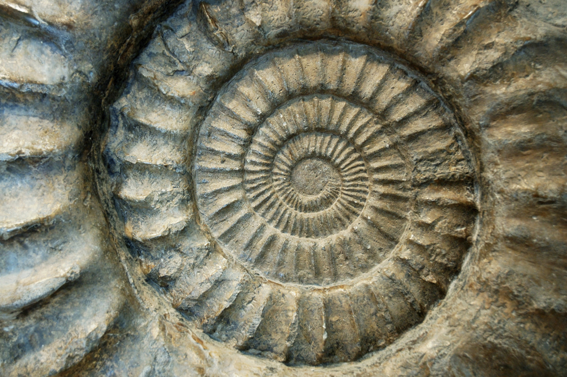
Geologic Time
Tutoring Session: Lesson 3

Slide 2
Lesson 3
Origin and Evolution of Life

Slide 3
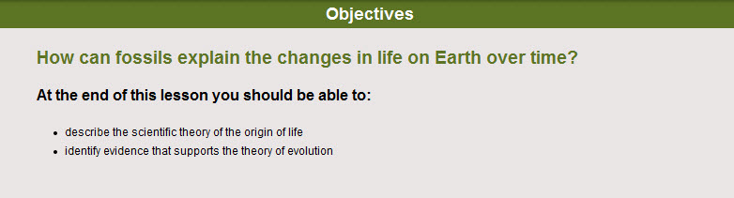
Objectives for this lesson:

Slide 4

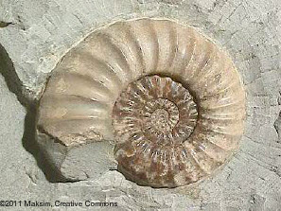
Scientists learn about Earth’s geological (the Earth itself) and biological (living things) history through evidence from rocks and fossils.
Fossil Record
A fossil record helps us to understand the past and why things are the way they are today.

Slide 5
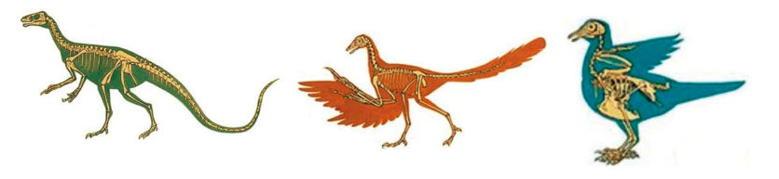
Biological Evolution
Theory of evolution
“Life on Earth did not always look the same as it does today. Life has evolved” (changed / altered).
“Evolution explains how new species of organisms arise or how existing organisms adapt to new conditions over time.”
Dinosaur
Modern day bird

Slide 6

“An adaptation refers to a characteristic of an organism that allows it to survive in a particular environment. “
When an adaptation (a change) makes an organism more likely to survive and reproduce, the organism may pass the new adaptation on to its offspring (babies); organisms with the new adaptation will produce more babies than organisms that don’t have the new adaptation. This process called: natural selection is why some organisms with certain adaptations survive and others do not, depending on Earth's changing conditions.

Slide 7
Chemical evolution:
The idea that the appearance of living systems (stuff) on Earth came from non-living molecules.

Slide 8
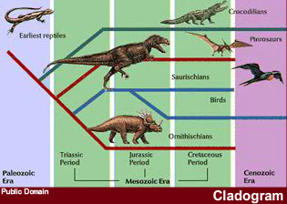
Fossil evolution
Living fossils: Creatures that are very similar to species that lived long ago (without much change) are called “living fossils”.
Phylogeny is studying how different organisms (plants/animals/etc.) are connected (related) through evolution (change over time).
We use something called a “cladogram” to show (in an image/diagram) how one organism is related to another one.

Slide 9
What to do for this lesson:
You need to create a virtual tour of a fossil (or group of fossils).
You will supply evidence of biological evolution over time by providing details on the origin and development of a fossil.
You must show (for full credit):
  the fossil record (who is [was] it related to (if known)
  the biological evolution of your fossil/fossil group
  Where can we find your fossil(s)
  The known evolution of you fossil(s) - phylogeny
  Any known species adaptations
  Pictures! (it is a virtual “tour”)
How to start:
  Introduce the fossil (or group of fossils)
  Create your tour
  Be sure to include a minimum of 10 discussion points, or “stops,” on your tour.

Slide 10
A picture of your fossil and when it lived on the Earth (what geologic time period)
A picture of the Earth/World/USA and show where your fossil lived/roamed
A picture of the fossil when it was alive / and the fossil (as a fossil)
Picture (and text) that talk/show any adaptations that your species went through
The phylogeny of your fossil (what species they are related too) pictures if you get them!
A caldogram for your species

Slide 11
